Slide 1


Book Recommendation System using Collaborative Filtering
Machine Learning – Unsupervised 2
Submitted by ~
Harsimar Singh Arora 12120011
Unnati Khinvasara 12120097
Rohini Purnima 12120027
Rohit Thakur 12120040
Mohit Kothari 12120035

Slide 2

BACKGROUND & SCOPE
Business Objective
Drive up the business revenue by increasing sales through enhancing user engagement
Problem Statement
Implementing a book recommendation system focused on improving customer experience & engagement by recommending relevant books
Approach
We used Crosswords’ Ratings History to build a recommendation system based on collaborative filtering
Success Criterias
AB Testing to evaluate metrics such as incremental revenue, clicks on recommendation pane, decrease in page bounces, change in books sold per user, etc.
Crossword Bookstore is a chain of bookstores
Recently launched their website for online presence
Wish to exploit the huge potential in e-commerce sale of books

Slide 3
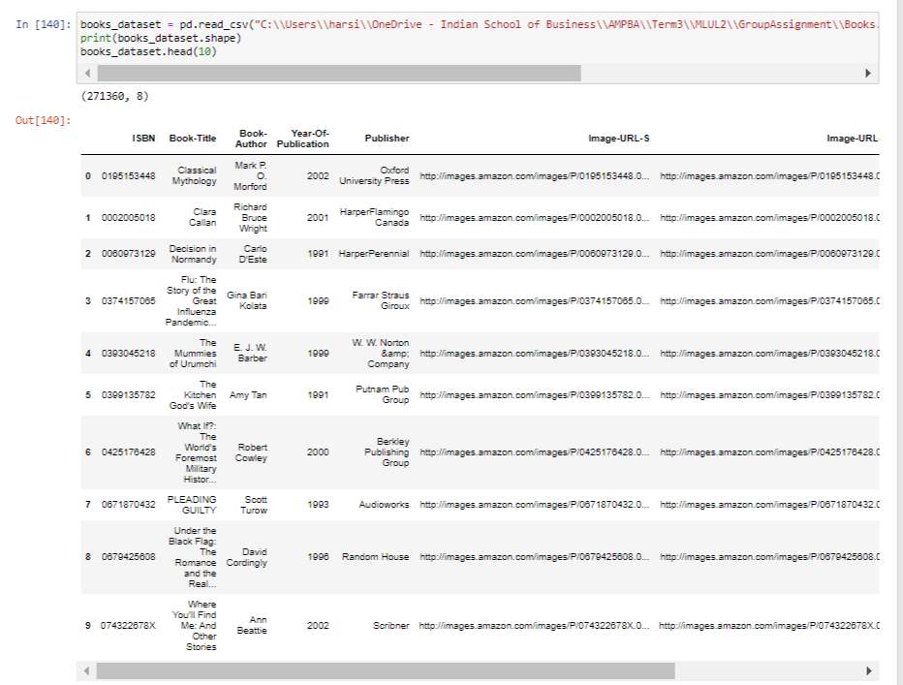
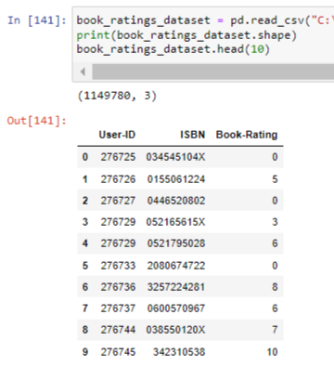
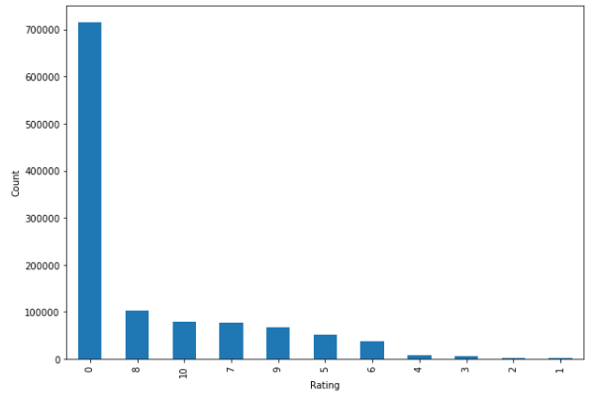
DATA DESCRIPTION
Books Dataset
(Title, Author, ISBN Code, Year of Publication)
271k total rows
Ratings Dataset
(UserID, ISBN Code, Book-Rating)
1.14 million ratings from 105k users

Slide 4
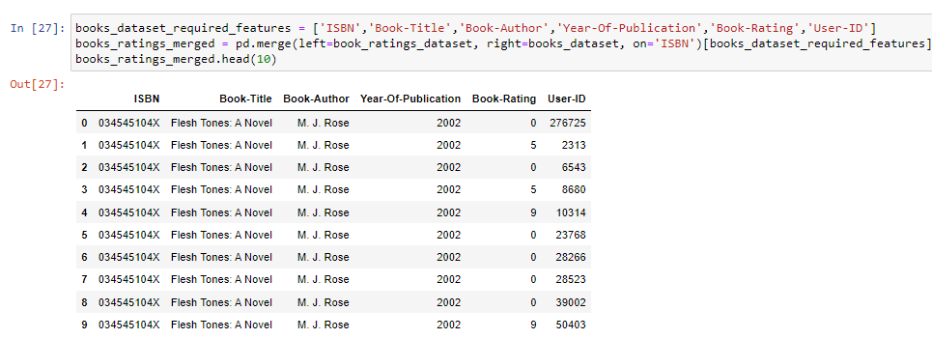
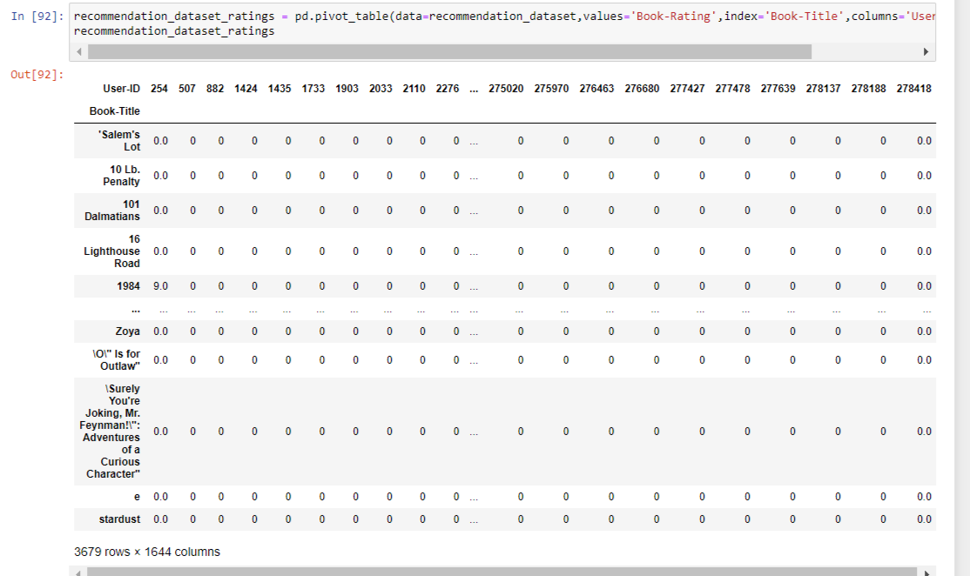
DATA PREPARATION
1
2
Pivot Table based on Criteria
Top Rated Books: List of 3679 books having >35 ratings
Top Users: List of 1648 users rated who have rated > 100 books
Merged Dataset based on ISBN Code
(ISBN, Book Title, Author, Book Rating, User ID)

Slide 5
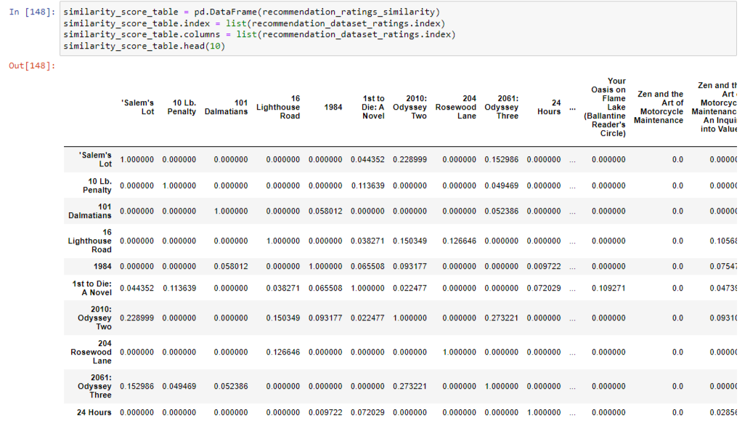
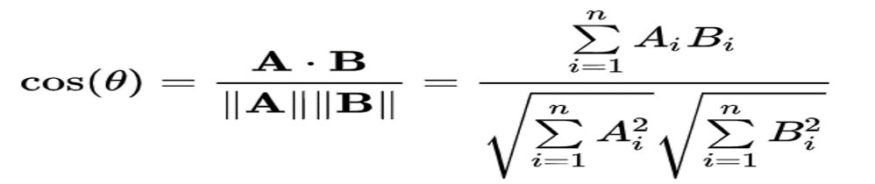
METHODOLOGY
Item-to-Item Collaborative Filtering
Main goal in our approach is to recommend the book most suited according to the rating given by users
Cosine Similarity Matrix
Metric Used - Cosine-Similarity
Cosine Similarity measures the similarity between two vectors
Dataset is sparse which means many ratings are undefined, hence Cosine Similarity is preferred
(Note - “Salem’s Lot” has highest cosine score of 0.22899 with “Odyssey Two”

Slide 6
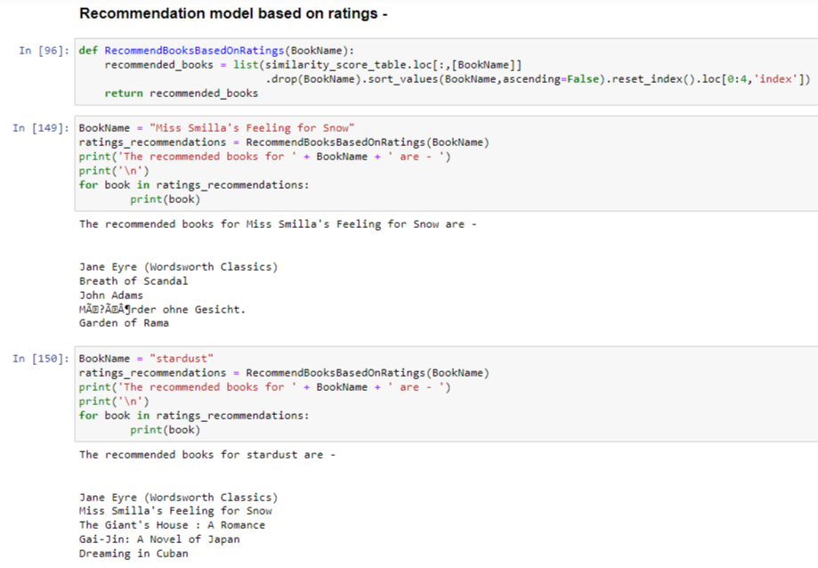
MODEL RESULT

Slide 7
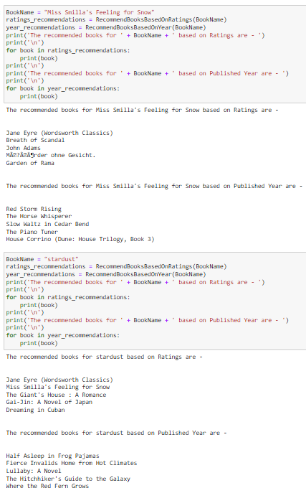
RECOMMENDATIONS
Adding other dimensions to the Recommendation Engine in addition to the User Ratings
Year of Publishing (Screenshots Attached)
Genre
Written Feedback (Text Analytics)
User Age Group
2. Adopt Hybrid Filtering Approach
Matching Recommendation Model with Available Inventory
Enhancement in Business Offerings in terms of Bundles or “Books of the Month”

Slide 8

“People don’t know what they want until you show it to them.”
~ Steve Jobs
THANKYOU!

